Slide 1

2020
伺服调试软件-InoDriverShop-用户手册介绍
汇报人：钱晨亮 时间：2020年5月
昆山纳博旺精工科技有限公司

Slide 2
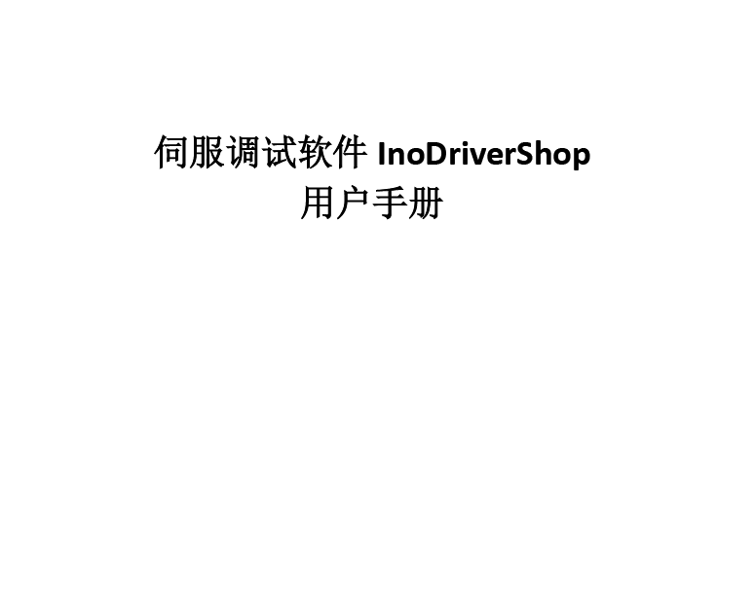
InoDriverShop-用户手册
数控
CNC床、电加工切割等

Slide 3
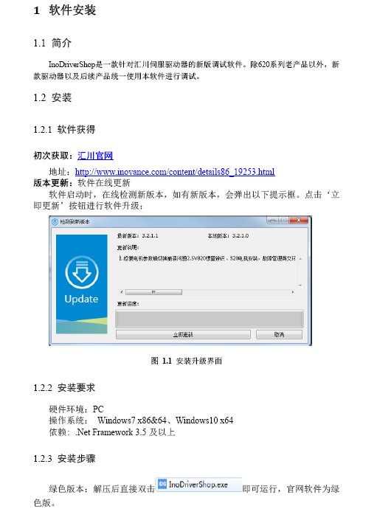
InoDriverShop-用户手册

Slide 4
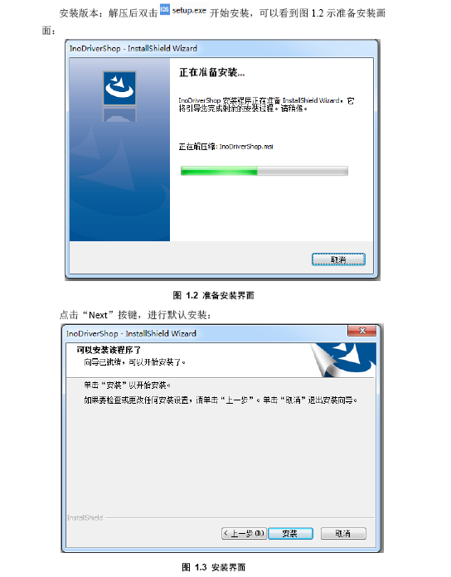
InoDriverShop-用户手册

Slide 5
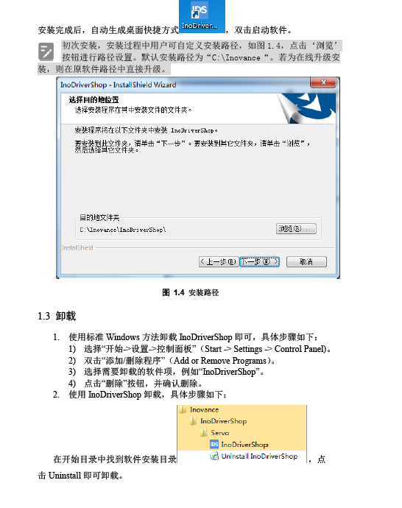
InoDriverShop-用户手册

Slide 6
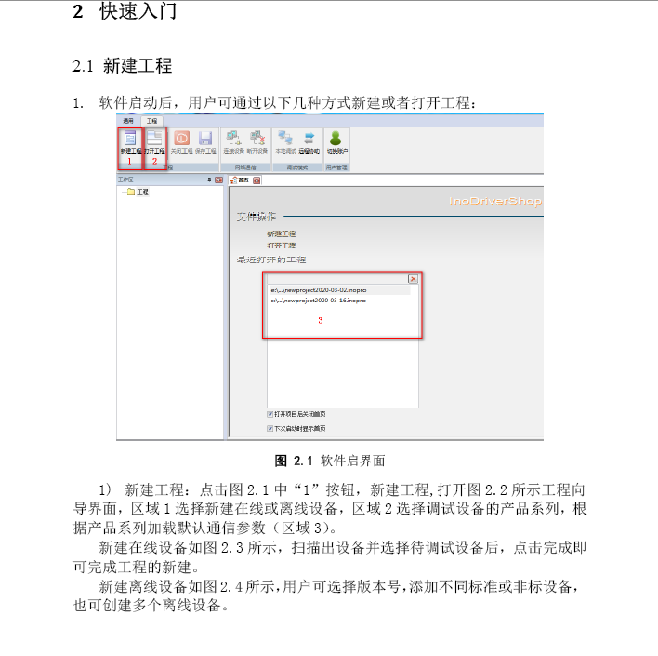
InoDriverShop-用户手册

Slide 7
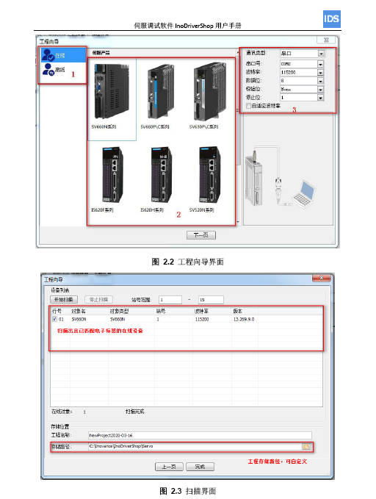
InoDriverShop-用户手册

Slide 8
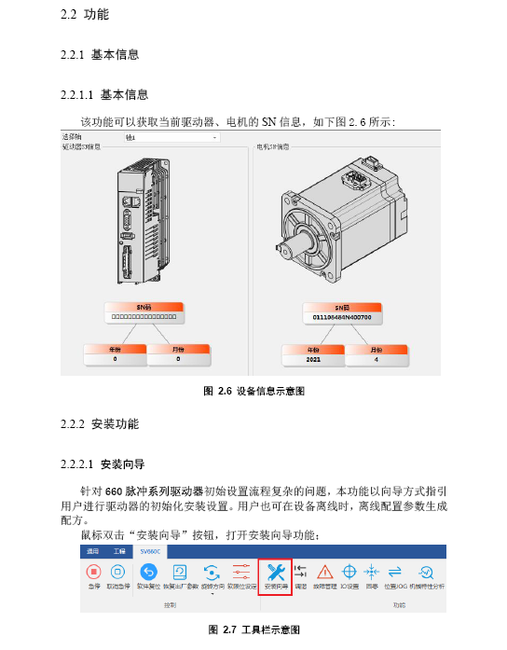
InoDriverShop-用户手册
数控
CNC床、电加工切割等

Slide 9
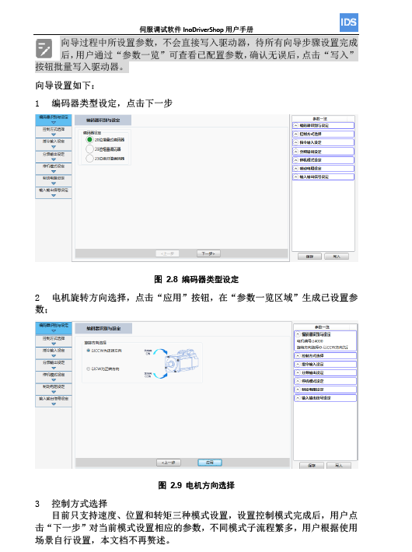
InoDriverShop-用户手册

Slide 10
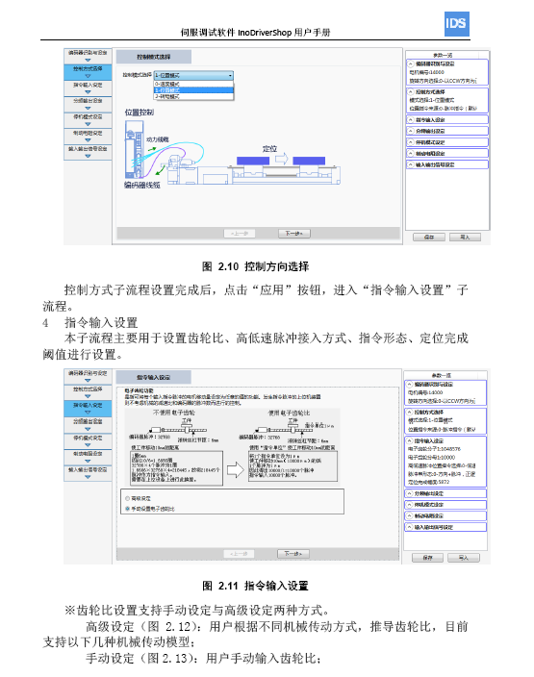
InoDriverShop-用户手册

Slide 11
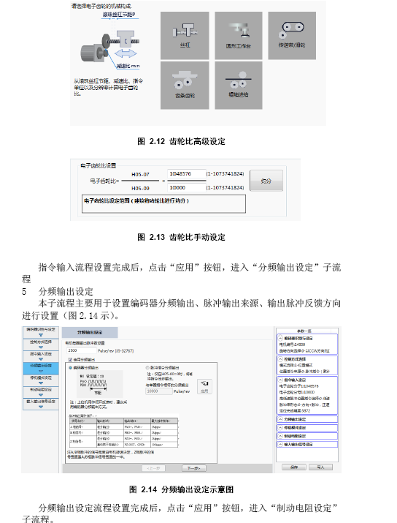
InoDriverShop-用户手册
数控
CNC床、电加工切割等

Slide 12
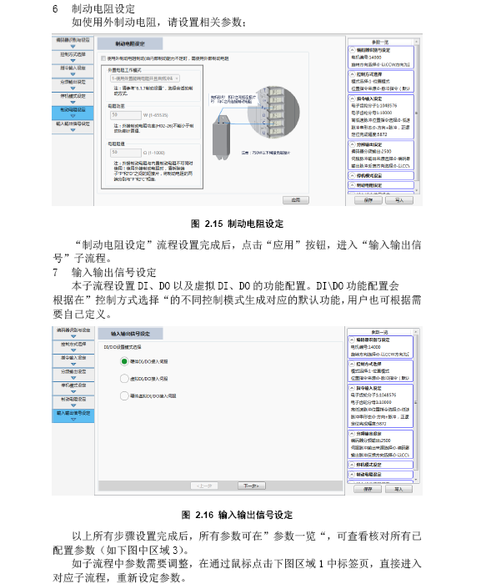
InoDriverShop-用户手册
数控
CNC床、电加工切割等

Slide 13
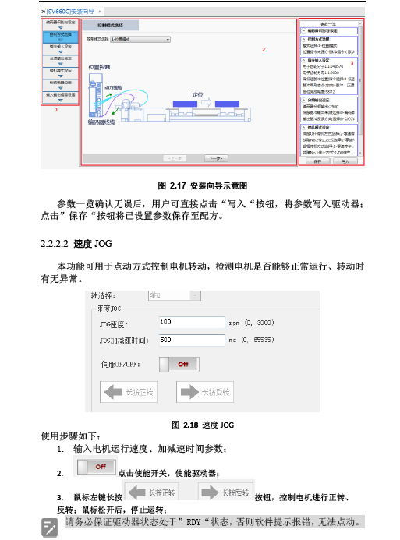
InoDriverShop-用户手册

Slide 14
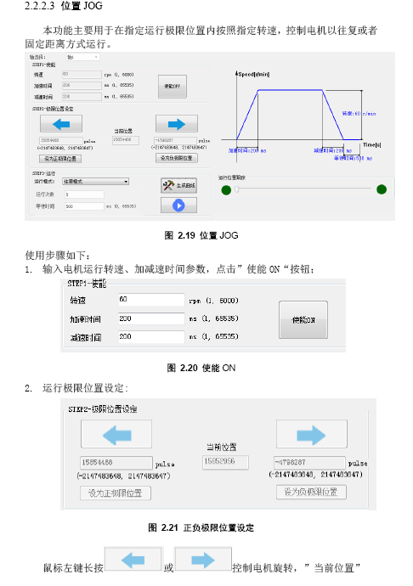
InoDriverShop-用户手册

Slide 15
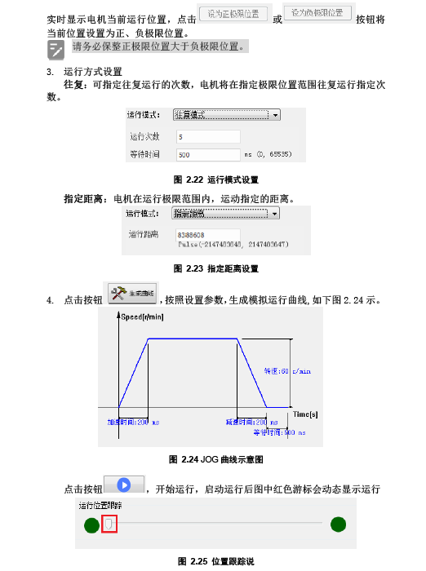
InoDriverShop-用户手册

Slide 16
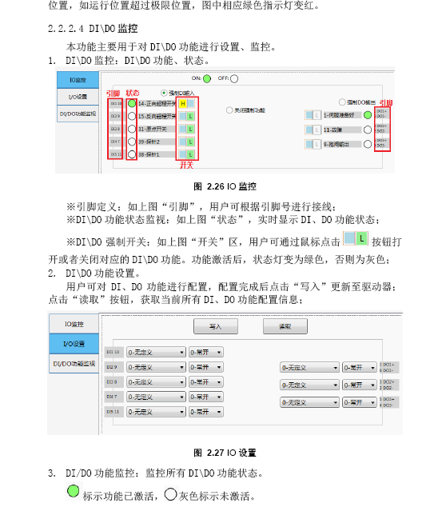
InoDriverShop-用户手册

Slide 17
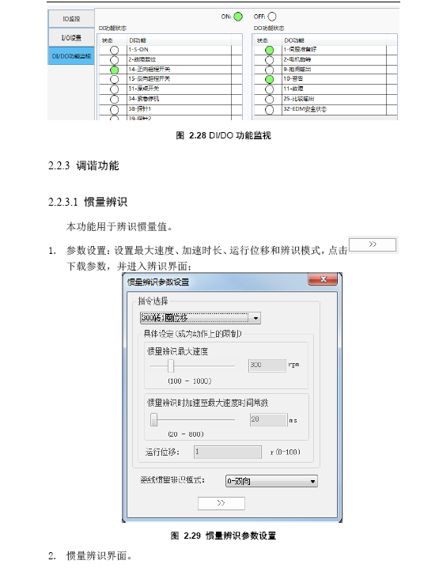
InoDriverShop-用户手册

Slide 18
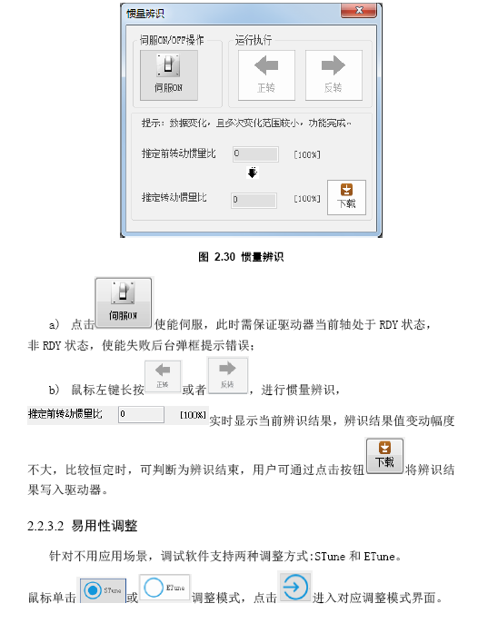
InoDriverShop-用户手册

Slide 19
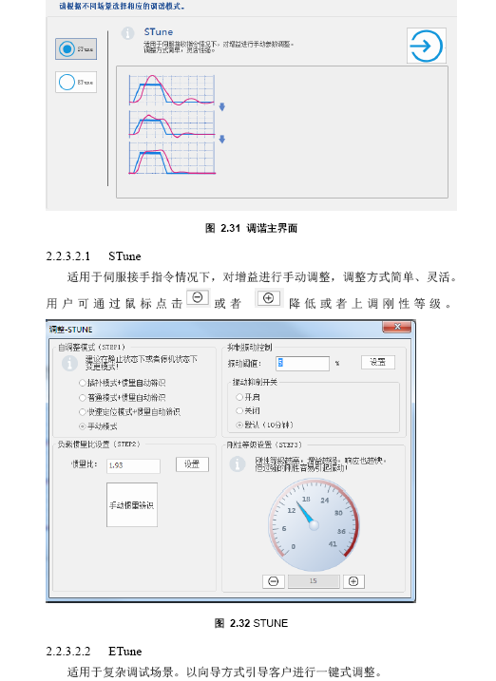
InoDriverShop-用户手册

Slide 20
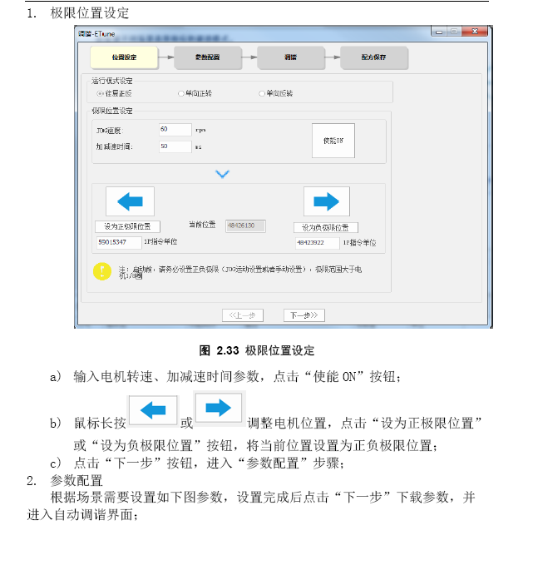
InoDriverShop-用户手册

Slide 21
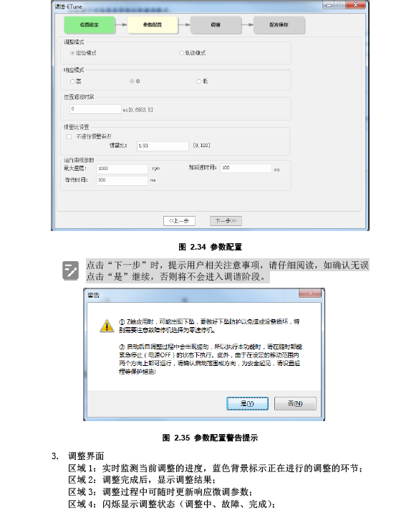
InoDriverShop-用户手册

Slide 22
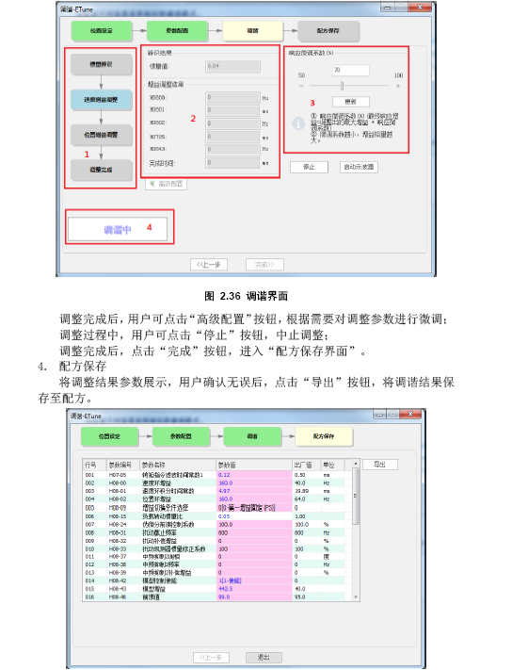
InoDriverShop-用户手册

Slide 23
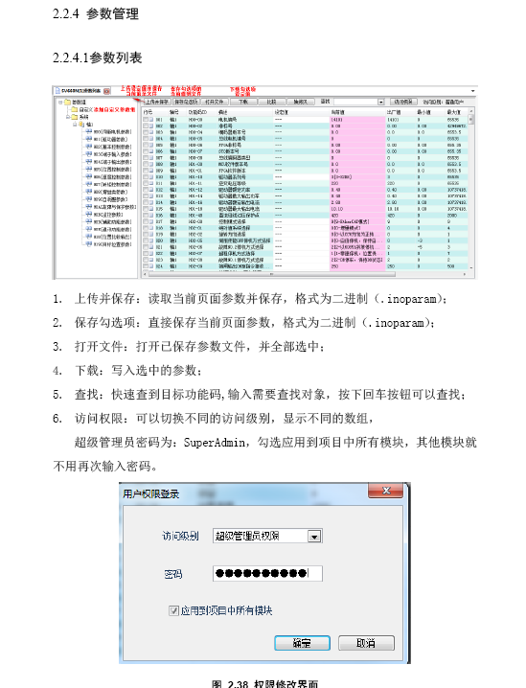
InoDriverShop-用户手册

Slide 24
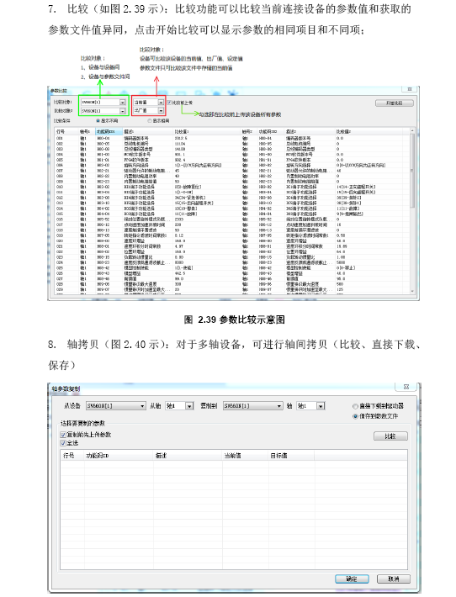
InoDriverShop-用户手册

Slide 25
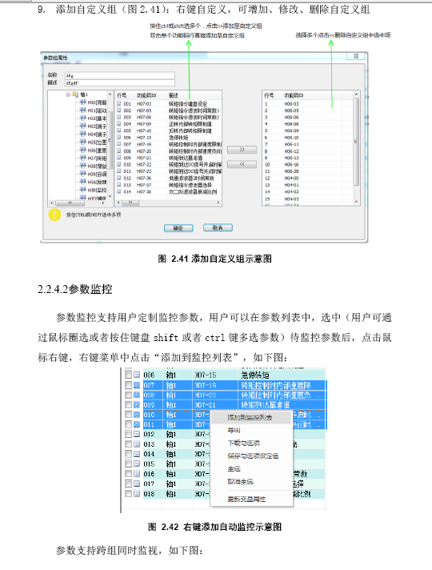
InoDriverShop-用户手册

Slide 26
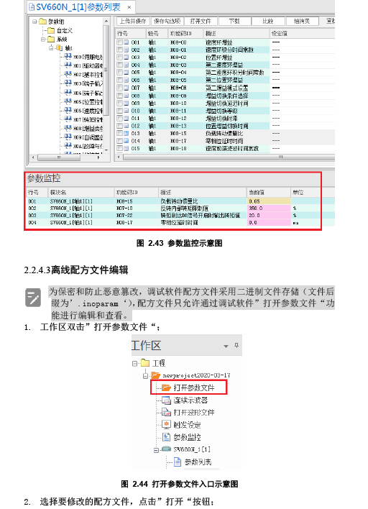
InoDriverShop-用户手册

Slide 27
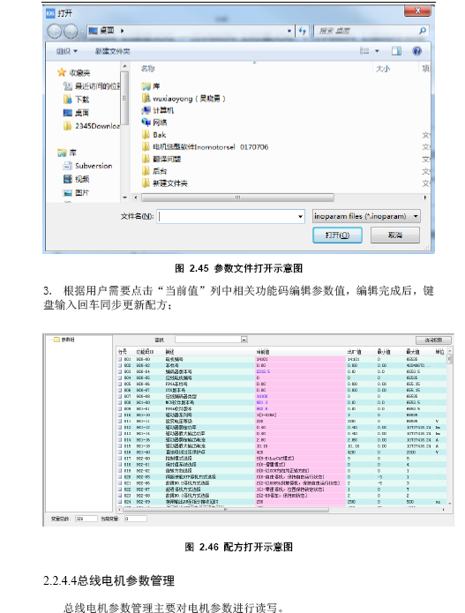
InoDriverShop-用户手册

Slide 28
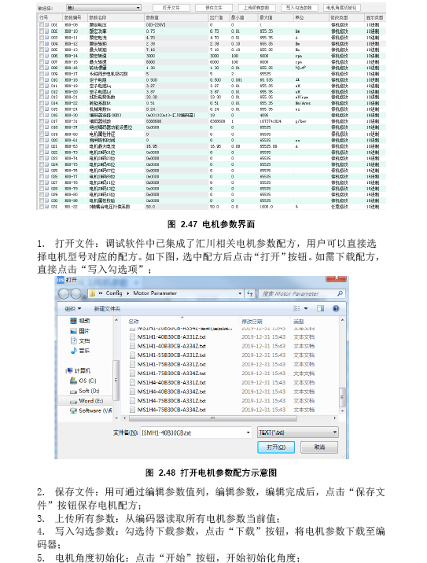
InoDriverShop-用户手册

Slide 29
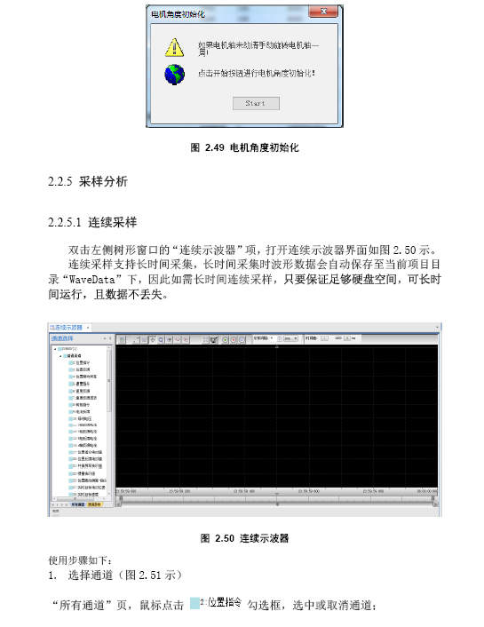
InoDriverShop-用户手册

Slide 30
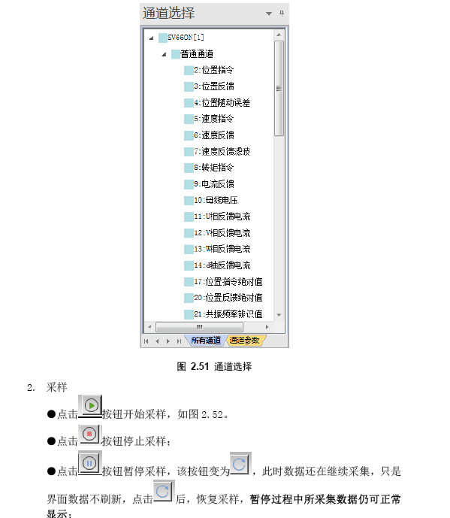
InoDriverShop-用户手册

Slide 31
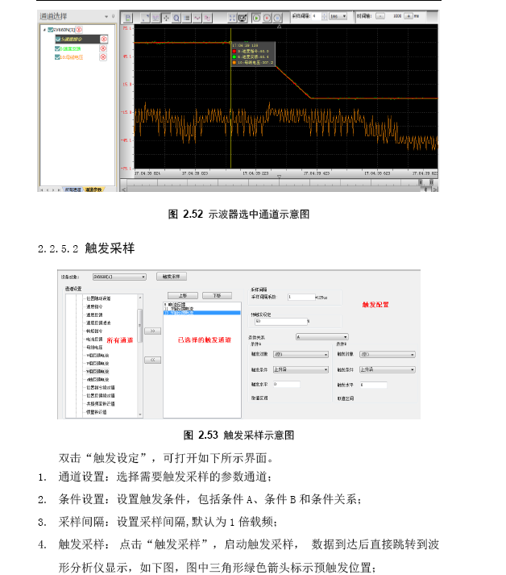
InoDriverShop-用户手册

Slide 32
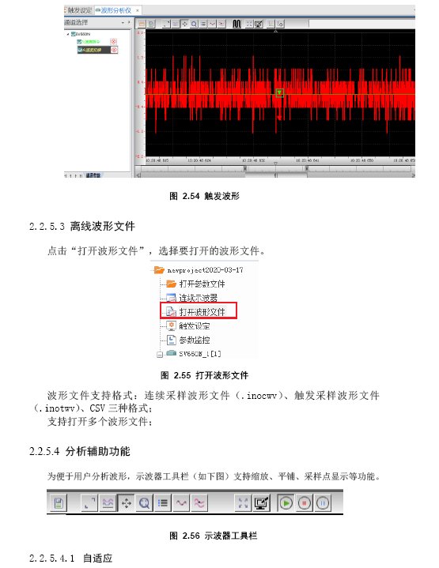
InoDriverShop-用户手册

Slide 33
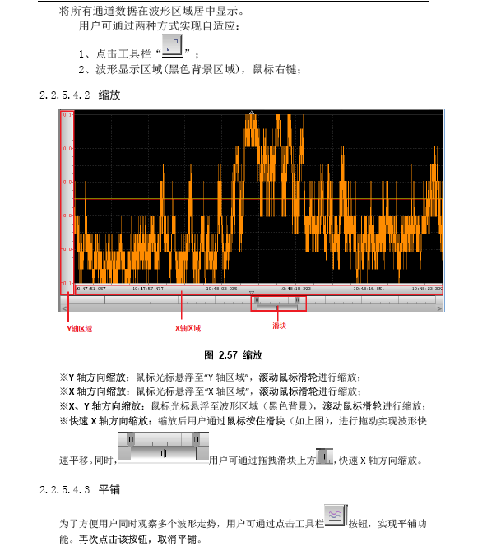
InoDriverShop-用户手册

Slide 34
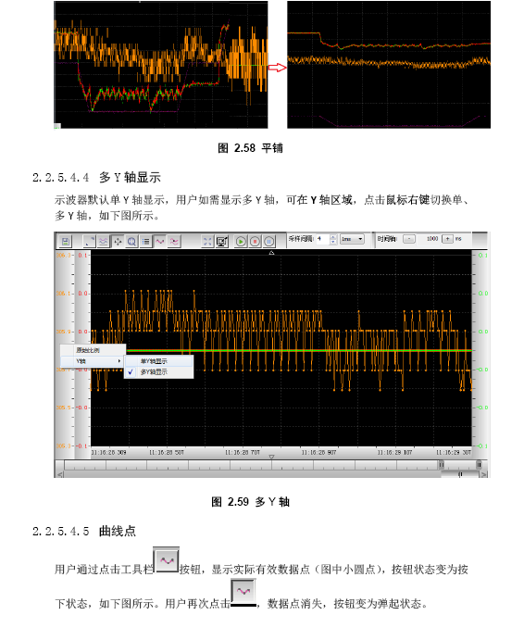
InoDriverShop-用户手册

Slide 35
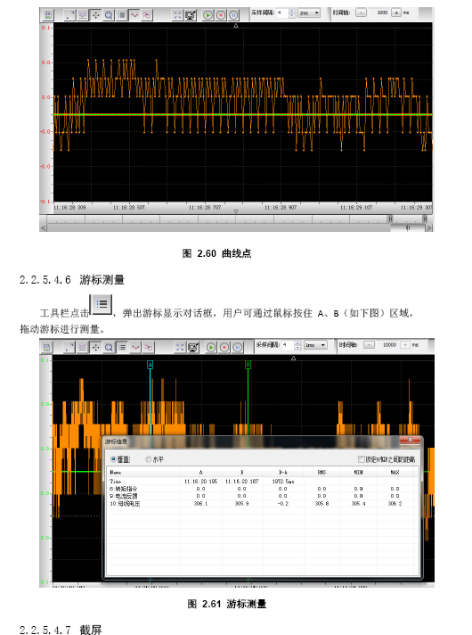
InoDriverShop-用户手册

Slide 36
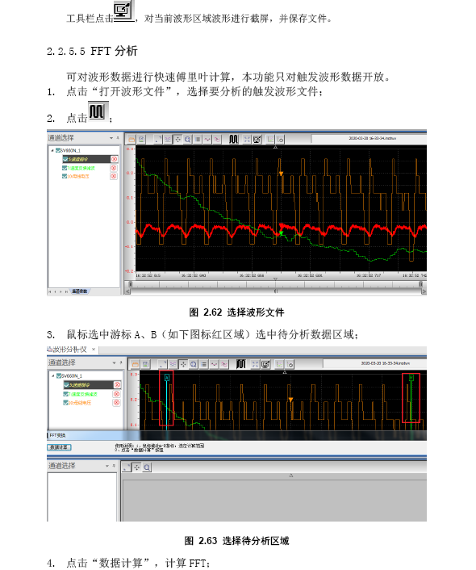
InoDriverShop-用户手册

Slide 37
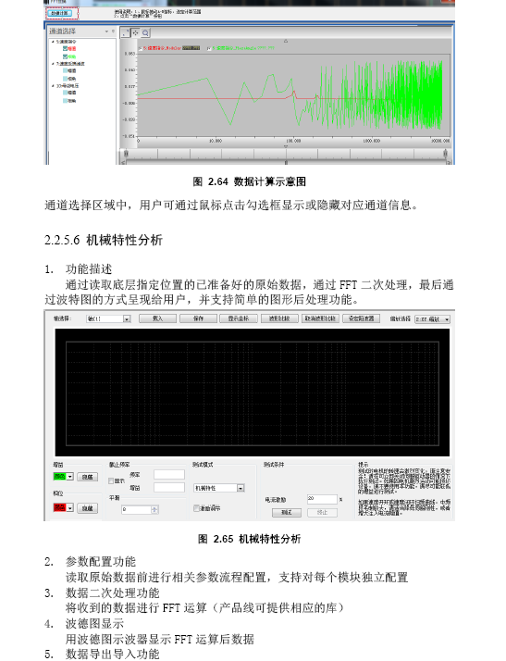
InoDriverShop-用户手册

Slide 38
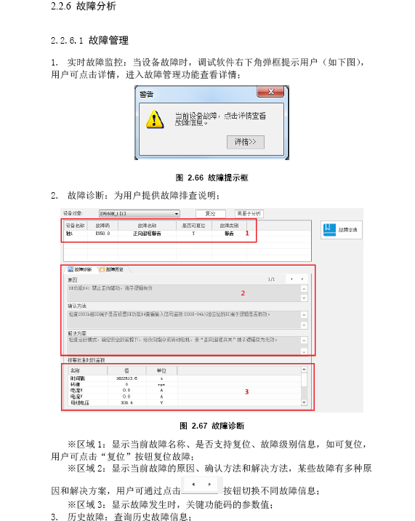
InoDriverShop-用户手册

Slide 39
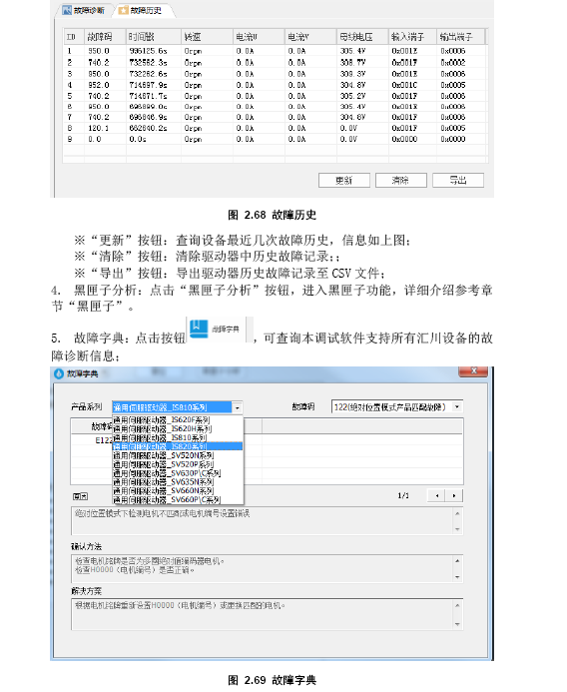
InoDriverShop-用户手册

Slide 40
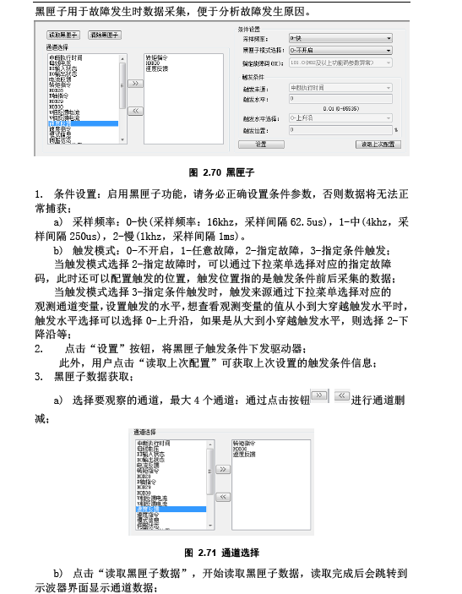
InoDriverShop-用户手册

Slide 41
InoDriverShop-用户手册

Slide 42
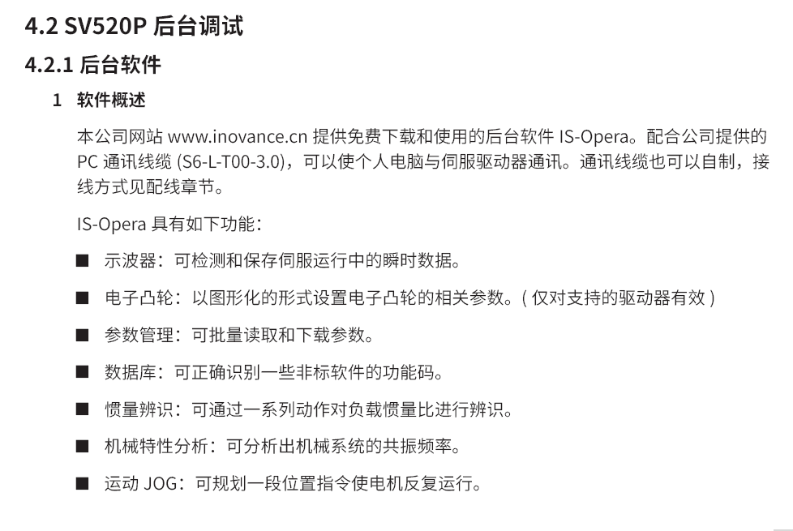
InoDriverShop-直线电机驱动器

Slide 43
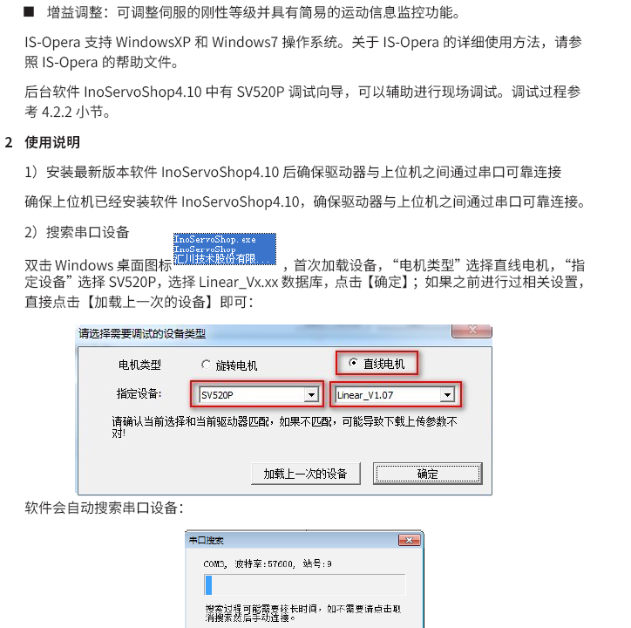
InoDriverShop-直线电机驱动器

Slide 44
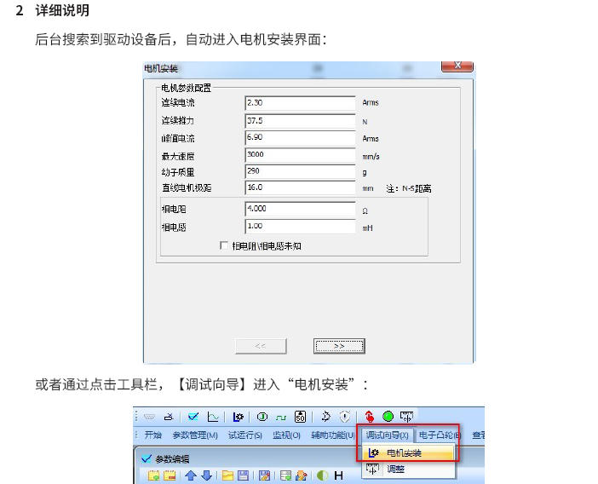
InoDriverShop-直线电机驱动器

Slide 45
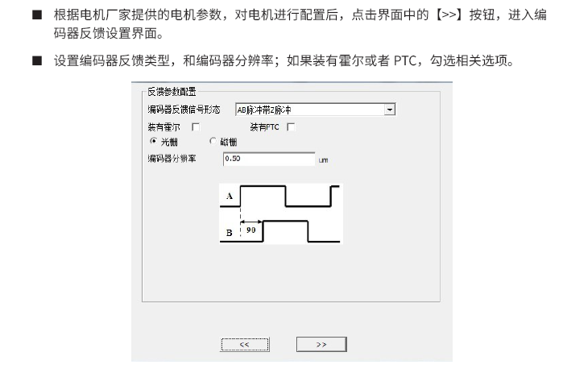
InoDriverShop-直线电机驱动器

Slide 46
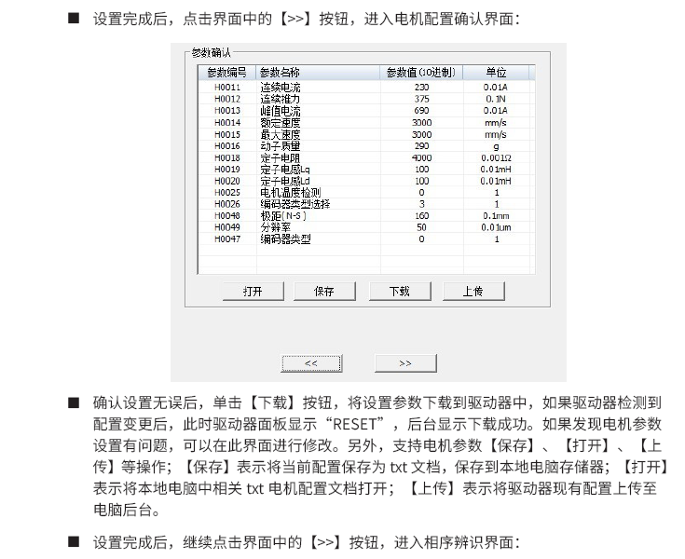
InoDriverShop-直线电机驱动器

Slide 47
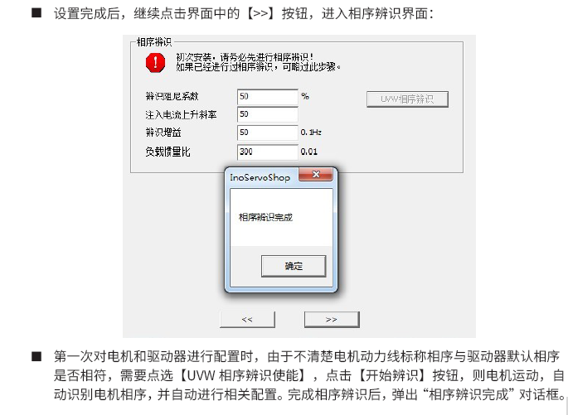
InoDriverShop-直线电机驱动器

Slide 48
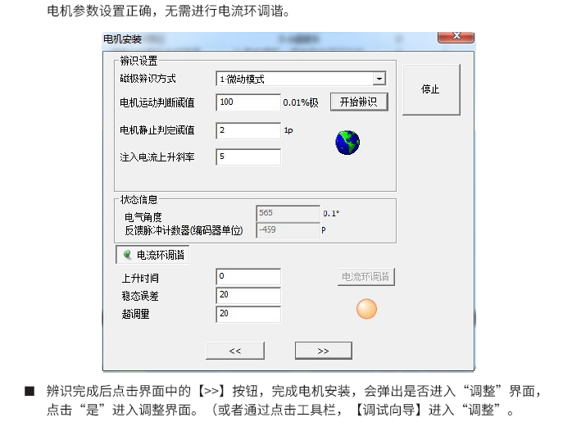
InoDriverShop-直线电机驱动器

Slide 49
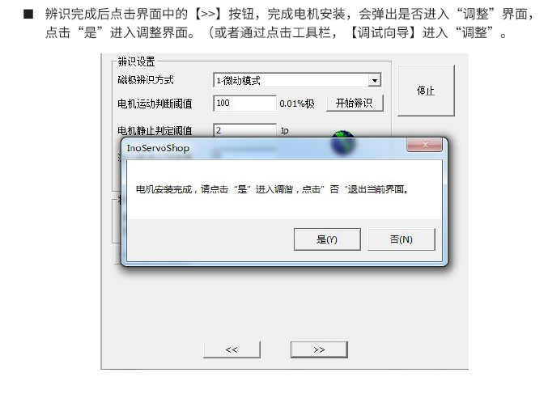
InoDriverShop-直线电机驱动器

Slide 50
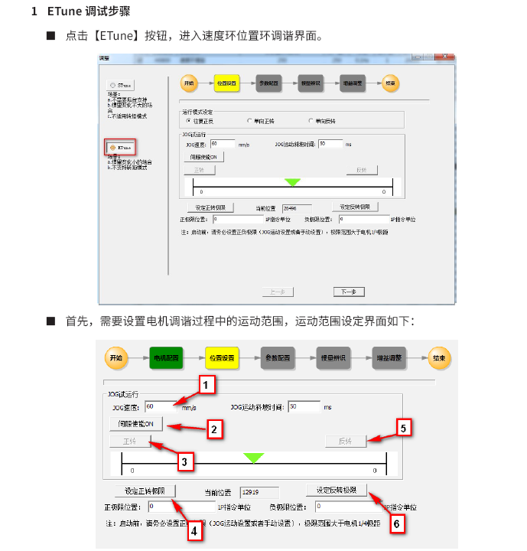
InoDriverShop-直线电机驱动器

Slide 51
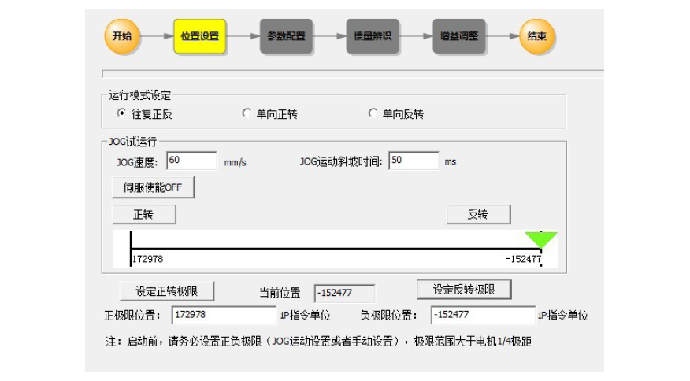
InoDriverShop-直线电机驱动器

Slide 52
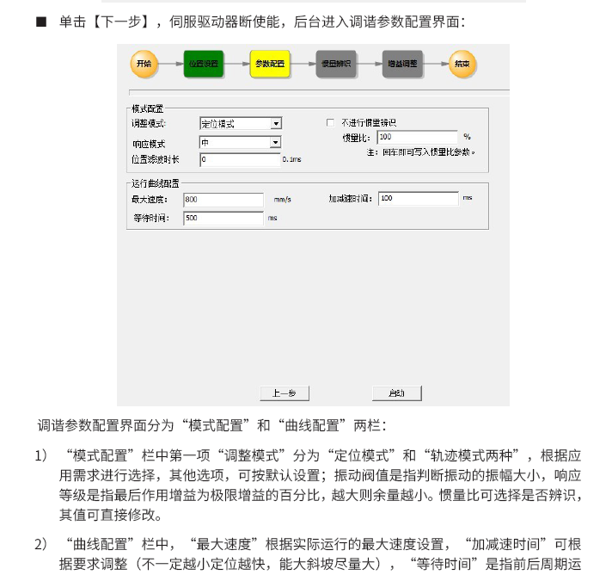
InoDriverShop-直线电机驱动器

Slide 53

InoDriverShop-直线电机驱动器

Slide 54

InoDriverShop-直线电机驱动器

Slide 55

InoDriverShop-直线电机驱动器

Slide 56

InoDriverShop-直线电机驱动器

Slide 57

InoDriverShop-直线电机驱动器

Slide 58

InoDriverShop-直线电机驱动器

Slide 59

InoDriverShop-直线电机驱动器

Slide 60

InoDriverShop-直线电机驱动器

